Slide 1
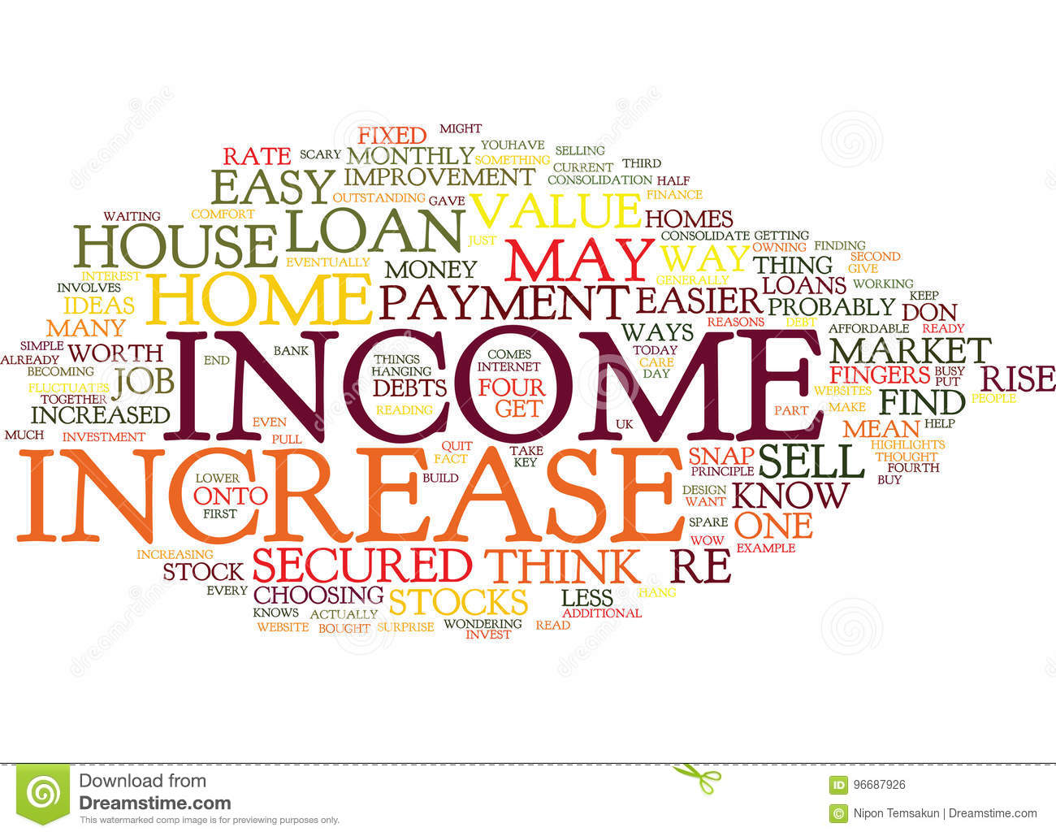
Applied Business Research
Annual Report Text Analysis Using Natural Language Processing (NLP) of private Banks
Research by:
Bharat Tata | Balam Sravan
190001 | 190048
Faculty guide:
Prof. Tushar Jaruhar

Slide 2

CONTENTS
01
Scope
02
Hypothesis
03
The Process
04
Analysis & Findings

Slide 3
Scope of Research
01.
To perform sentiment analysis and find out the amount of factual and perceptual data given in annual reports of some Indian banks
02.
To determine if existing sentiment analyzers can accurately predict the sentiment for the given data corroborated with market data.

Slide 4
Hypothesis
Private Bank
H1 : 0
H1: A
Existing Analyzers are appropriate for banking sector text analysis
Existing Analyzers are not appropriate for banking sector text analysis
Existing Analyzers are appropriate for banking sector text analysis
Existing Analyzers are not appropriate for banking sector text analysis
H2 : 0
H2 : A
Factual Information
Perceptual Information

Slide 5
The Process
Phase -1 Research study
What is Text Analysis?
An exhaustive process aimed at studying and understanding natural or everyday language using machine learning algorithms. The prime uses of text analysis are fraud/terror detection, human-machine interface,
What is NLTK
Natural Language Toolkit or NLTK is a package in python which helps in text analysis, its It was developed by Steven Bird and Edward Loper in the Department of Computer and Information Science at the University of Pennsylvania in 2001. NLTK includes graphical demonstrations and sample data.
Similarly, Text Blob is a Python library for processing textual data. It provides a simple API for diving into common natural language processing (NLP) tasks such as part-of-speech tagging, noun phrase extraction, sentiment analysis, classification, translation, and more.

Slide 6


The Process
Phase -2 Selecting sample
The Banks we analyzed
AXIS bank
Yes bank
Annual reports from March- 2017 to March 2020
Annual reports from March- 2017 to March 2020

Slide 7
The Process
Phase -3 Research Process
Text Extraction
Corpus Formation
Text Preprocessing
Sentiment analyzer
Text blob
Sentiment, Polarity analysis
Nltk Vader

Slide 8

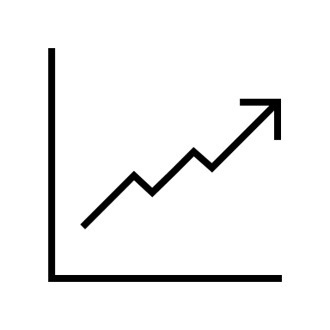
The Process
Phase -4 Refining Research
Key Words
We refined the research into next level by finding out the key common words used by the management in their annual report which showed some impact on their overall performance.
Real time impact
Once the sentiment of the author was found, we tried to find the time which author mentioned, check if there was any such impact in their share prices, surprisingly within the positive / negative sentiments, the market flow was showing raise and fall.

Slide 9
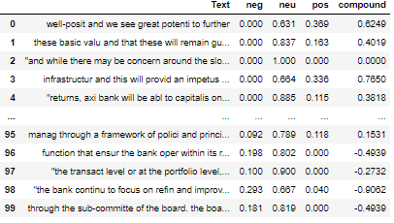


Results
Text blob Sentiment Analyzer
Vader Analyzer

Slide 10
Results Analysis
Text blob Sentiment Analyzer
Vader Analyzer
Polarity is a score which will be either -1 or +1 where -1 depicts negative sentiment and vice-versa.
The above results are of YES bank which shows author is expressing their company neither bad or good tone but neutral for audience.
The Subjectivity tells us that what percent of facts are included in the text or the text is of emotions like I feel, it could be like this.
We could find that the author has embedded a lot of Opinated text compared to Factual text
The Compound score is a metric that calculates the sum of all the lexicon ratings which have been normalized between -1(most extreme negative) and +1 (most extreme positive).
positive sentiment : (compound score >= 0.05) neutral sentiment : (compound score > -0.05) and (compound score < 0.05) negative sentiment : (compound score <= -0.05)

Slide 11
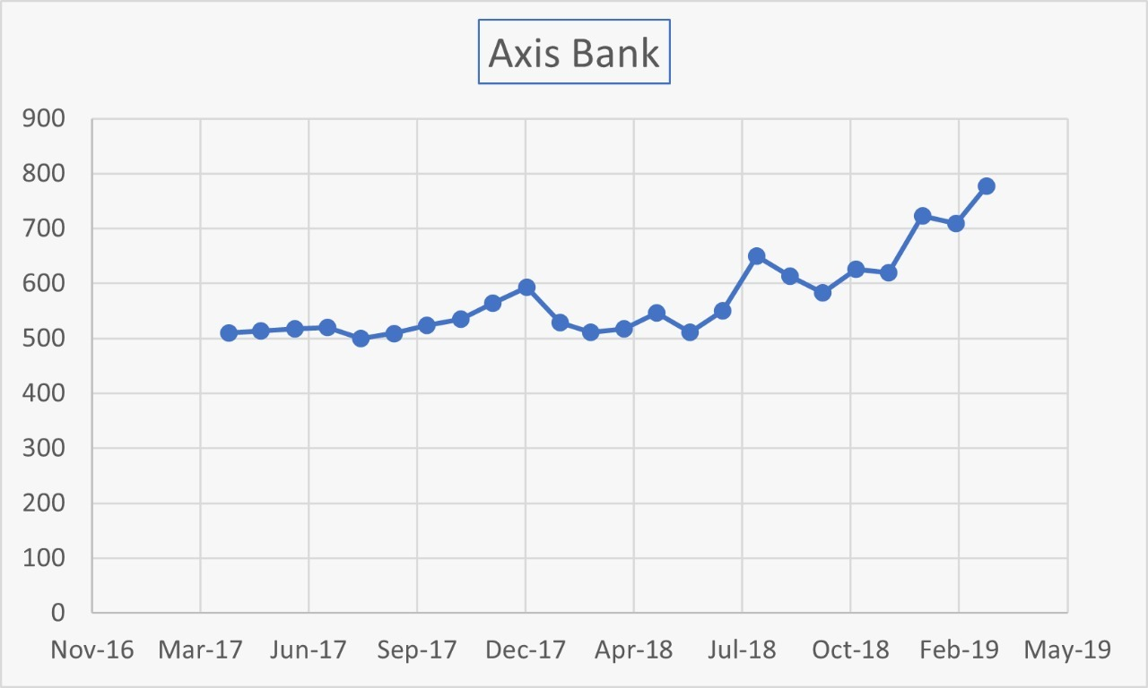
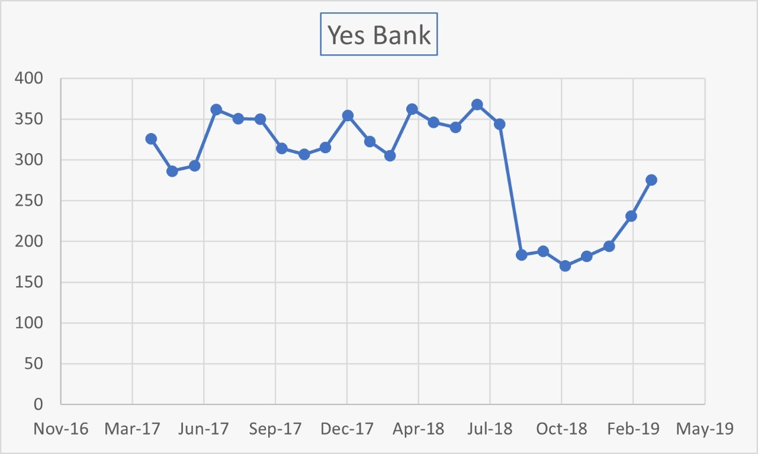
Findings
Once the sentiment analysis is done, we have checked the stock prices of respective 3-year period of our analysis which showed that within the positive and negative sentiment announced by authors in report have shown an effect on their stock prices for given period.

Slide 12
Findings
Sentiment Analyzers : H1
The existing sentiment analyzers however useful in analyzing everyday textual data are not compatible with data from banking sector
Annual Report Analysis: H2
A all text has been categorized as unbiased while opiniated data stands at 82%. This warrants further study using advanced methods.

Slide 13
Recommendation & Conclusion
Conclusion
With the project we can conclude that the private banks, when they announce their financial year ending results, they consider both the positive and negative elements of the year, they showcase the goodwill of positivity instead of showing the actual figures happened and write opinated report which tends to say the company will be growing or is expected to grow at a certain price.
Recommendations
Within the analyzers and text analytics packages like NLTK and Text Blob its easy to analyze text and conclude on the positive or negative context by analyzing the type of words but when it comes to financial reports and annual reports we can't conclude based on words as figures and facts will be undervalued.
Our strong recommendation is to develop a library specific to Financial reports/ Annual reports which will be capable of analyzing each of facts and figures to derive at a conclusion

Slide 14

Team members
Faculty guide
Balam Sravan
Bharat Tata
Prof. Tushar Jaruhar
MBA – Business Analytics
190A3010048
MBA – Business Analytics
190A3010001

Slide 15
Thank You
Questions
Feedback
Comments

